Slide 1
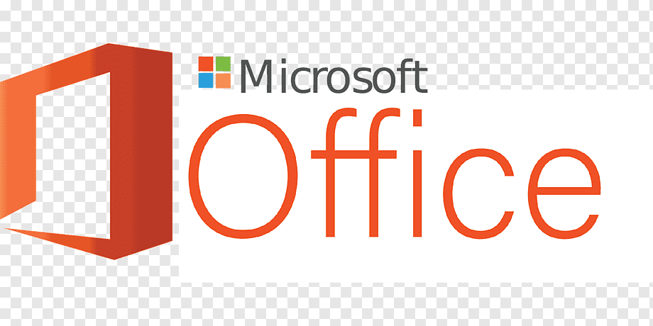
Introduction of MS-Office

Slide 2
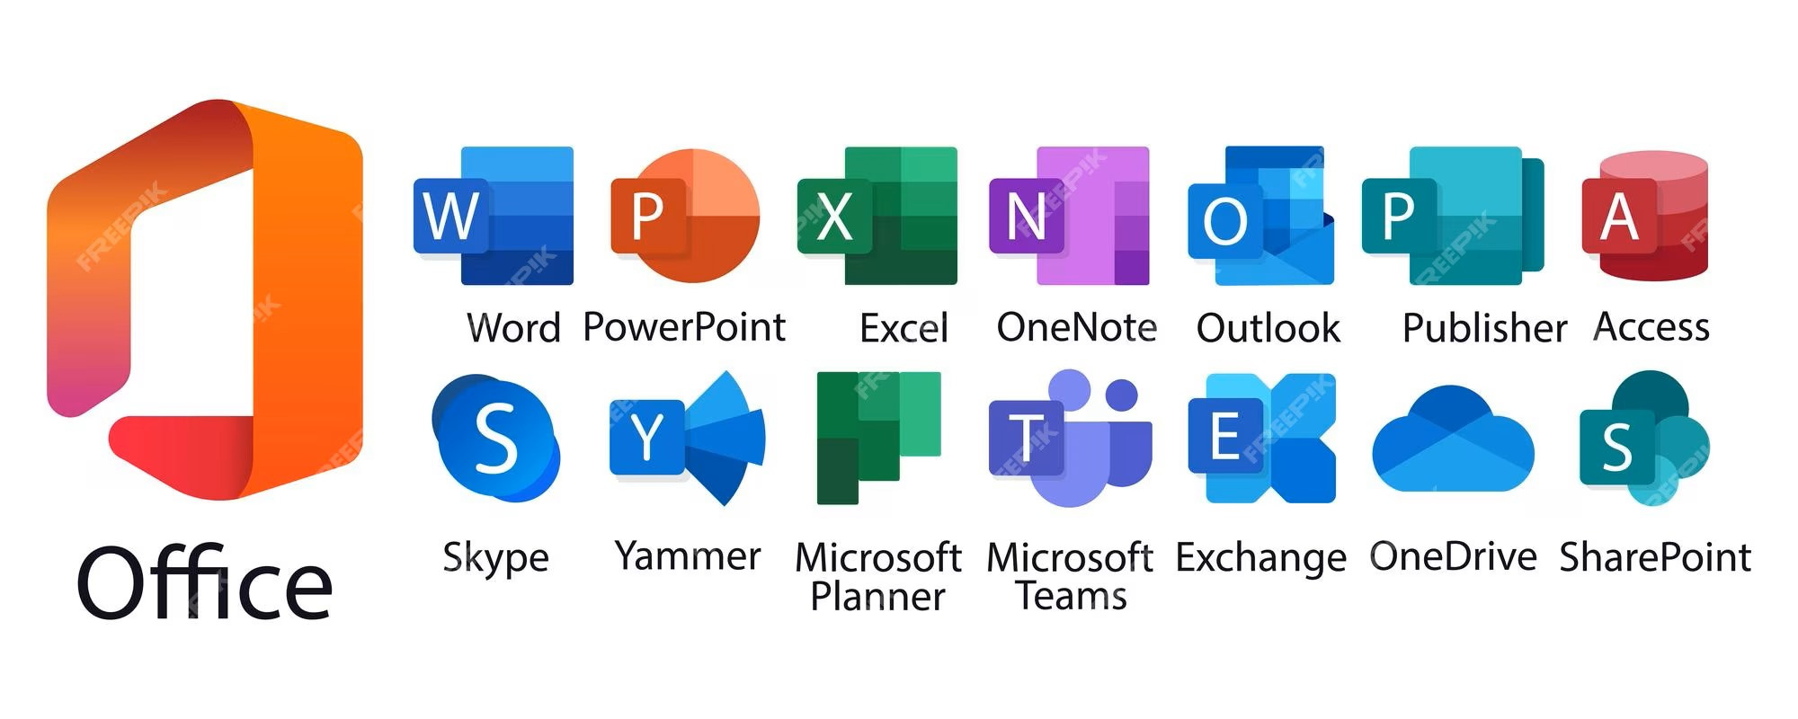
Microsoft Office is a suite of productivity applications developed by Microsoft. It includes several programs designed to help users create documents, spreadsheets, presentations, emails, and more. Some of the most commonly used applications in Microsoft Office include:

Slide 3
Word: A word processing program used for creating documents such as letters, reports, resumes, and more.
Excel: A spreadsheet application used for creating and analyzing data with tools for calculations, graphs, and data visualization.
PowerPoint: A presentation software that allows users to create slideshows with text, images, animations, and multimedia elements.
Outlook: An email client that also includes a calendar, task manager, and contact manager.
Access: A database management system for organizing and manipulating large amounts of data.
OneNote: A digital notebook that allows users to take notes, draw, organize information, and collaborate with others.
These applications are widely used in various industries, educational institutions, and personal settings due to their user-friendly interfaces and powerful features that facilitate productivity and collaboration.

Slide 4
Microsoft Word is a word processing program developed by Microsoft. It's a part of the Microsoft Office suite and has been a staple in the computing world for several decades. Here's a bit about its background:
Early History:
1970s and 1980s: The origins of Word date back to the early 1970s with the creation of the first word processor, "Bravo," at Xerox PARC. Over time, this evolved into programs like "Xerox Bravo," "Xerox Alto," and "Xerox Star."
1983: Microsoft released the first version of Word for MS-DOS, initially called "Multi-Tool Word." It was later renamed "Microsoft Word."
1989: The release of Word for Windows marked a significant milestone, as it became a part of the Microsoft Office suite. This version was notably more user-friendly and gained popularity rapidly.

Slide 5
Features and Evolution:
User Interface: Word introduced a graphical user interface, making it easier for users to format text, insert images, and create various document types.
Integration with Office Suite: As part of the Office suite, Word integrated seamlessly with other Microsoft programs like Excel and PowerPoint.
Regular Updates: Microsoft has consistently updated Word, introducing new features, templates, collaboration tools, and improved compatibility with different file formats.

Slide 6
Key Features:
Formatting Tools: Word offers extensive formatting options for text, paragraphs, and pages, allowing users to create professional-looking documents.
Templates: It provides pre-designed templates for various document types, such as resumes, letters, reports, and newsletters.
Collaboration Tools: Word offers features for real-time collaboration, allowing multiple users to work on the same document simultaneously.
Integration: It integrates with other Office applications, enabling easy data sharing and cross-application functionality.

Slide 7
Modern Word:
Cloud Integration: Microsoft has transitioned Word to cloud-based versions like Office 365 and Microsoft 365, enabling users to access and collaborate on documents from anywhere.
Continued Updates: Microsoft regularly updates Word, adding new features, improving security, and enhancing user experience.
Today, Microsoft Word remains one of the most widely used word processing applications globally, catering to various users, from students to professionals, due to its versatility, user-friendly interface, and integration with other productivity tools.

Slide 8
Thank You

